Slide 1
(Dissertation for Ph.D. in Mfr. & Tech. Mgmt.)
Three Essays on
“Operations & Supply Chain Agility,
Emerging Technologies, and Environmental Dynamism”
Zhezhu “Wen”
Nov. 20th, 2020
Dissertation Committee
Dr. Paul Hong (Chair) Professor, IOTM
Dr. Xinghao Yan Associate Professor, IOTM
Dr. Collin Gilstrap Assistant Professor, Finance
Dr. James Bland Assistant Professor, Economics
Dr. John Doe Assistant Professor, IOTM
Notes:
https://www.utoledo.edu/offices/marketing/brand-guide/guide.html

Slide 2
8th Global Supply Chain Management Conference 2020
Operations & Supply Chain Agility and
National Culture
Zhezhu Wen, Paul Hong
Department of IOTM
The University of Toledo, OH
{Zhezhu.wen, Paul.hong}@utoledo.edu
December 10th, 2020
Notes:
https://www.utoledo.edu/offices/marketing/brand-guide/guide.html

Slide 3
Outline
Background and research motivation
Literature review and theoretical development
Data and analytical framework
Preliminary empirical evidences
Limitations, future work, and discussion

Slide 4
Background and Research Motivation: Agility
Firms have multiple layers of mechanisms through which they respond to the changing environment.
  Long-term uncertainties inherent to the industry itself
    Choice of manufacturing technologies, decoupling strategy, operation model, business model, and business strategies
  Mid-term foreseeable uncertainties from economic conditions
    Periodic structural changes through planning activities such as sales and operations planning (S&OP)
  Short-term uncertainties
    Skillful utilization of slack resources, slack capacity, and/or improvisation
Operation and Supply Chain Management (OSCM) Agility is “a strategic ability that assists organizations to rapidly sense (cognitive) and responds (physical) to internal and external uncertainties via effective integration of supply chain relationships.” (Fayezi et al., 2017)

Slide 5


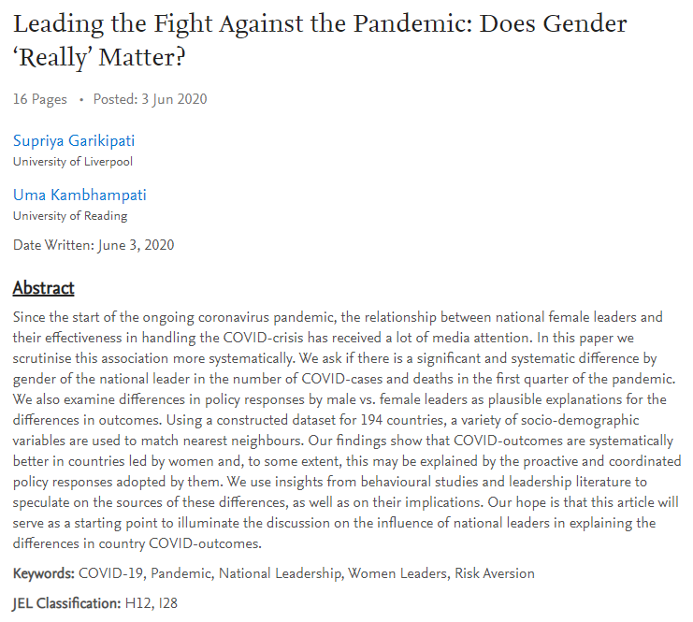
Is the ability to sense and respond in face of uncertain events somewhat related to the national culture?

Slide 6
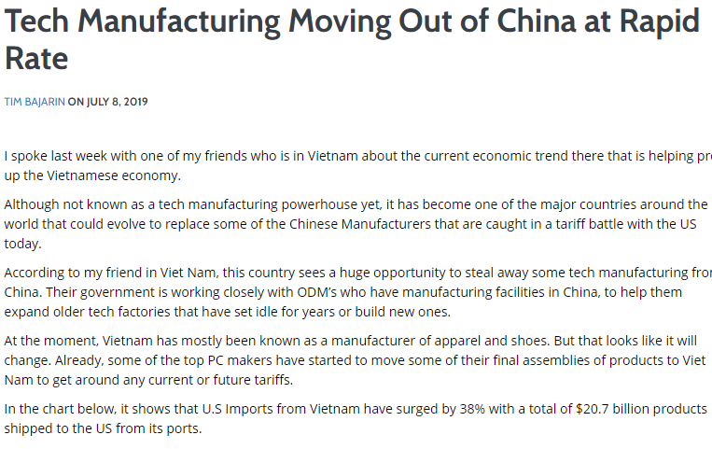
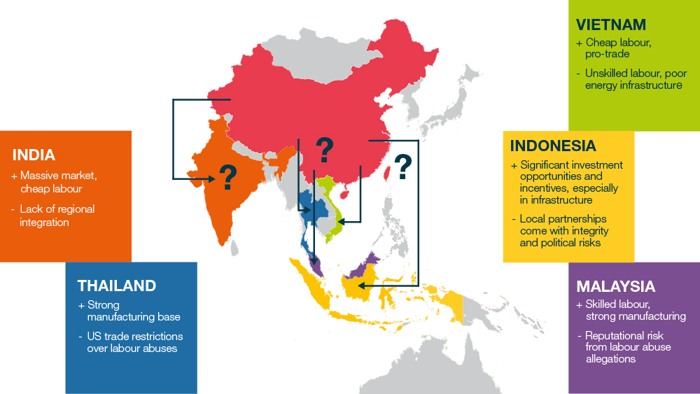
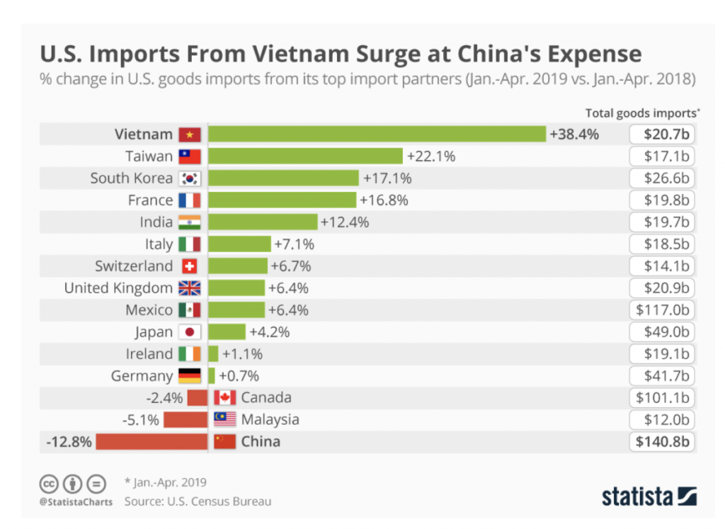
Background and Research Motivation: Supply chain diversification
There is a growing awareness in the risk of relying on overly concentrated supply chain networks.
Post-COVID supply chain diversification process will require firms to re-learn the way strategic planning and operations are being carried out in a new cultural contexts.
Reference: https://www.controlrisks.com/riskmap/analyst-picks/asia-supply-chains-options

Slide 7
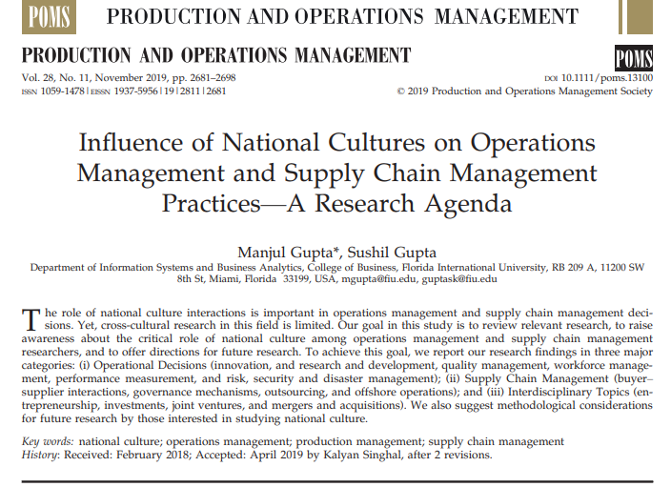
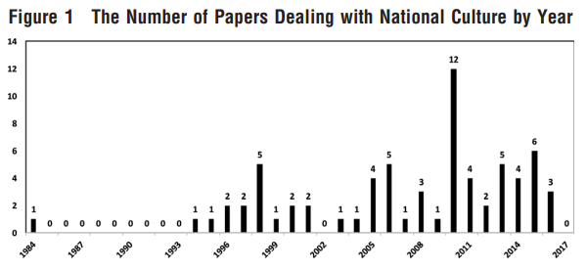
Background and Research Motivation: Supply chain diversification
Surprisingly, the impact of the national culture has received relatively little attention in the OSCM literature (Boscari et al, 2018; Gupta & Gupta, 2019)
“Future research should investigate how national culture affects goals, objectives and subsequent decisions pertaining to inventory management, subcontracting, and other OM/SCM areas. Decisions about safety stock levels and embracing the just-in-time concept may be influenced by national culture. The tendencies to hoard, to value time and to build operational slack to mask inefficiencies (e.g., in production scheduling) are likely to have their roots in the national culture.”

Slide 8
Research Questions
1) What is the impact of the national culture in firm’s choice of OSCM agility practices?
2) Is the agility practice more effective in certain national culture?

Slide 9
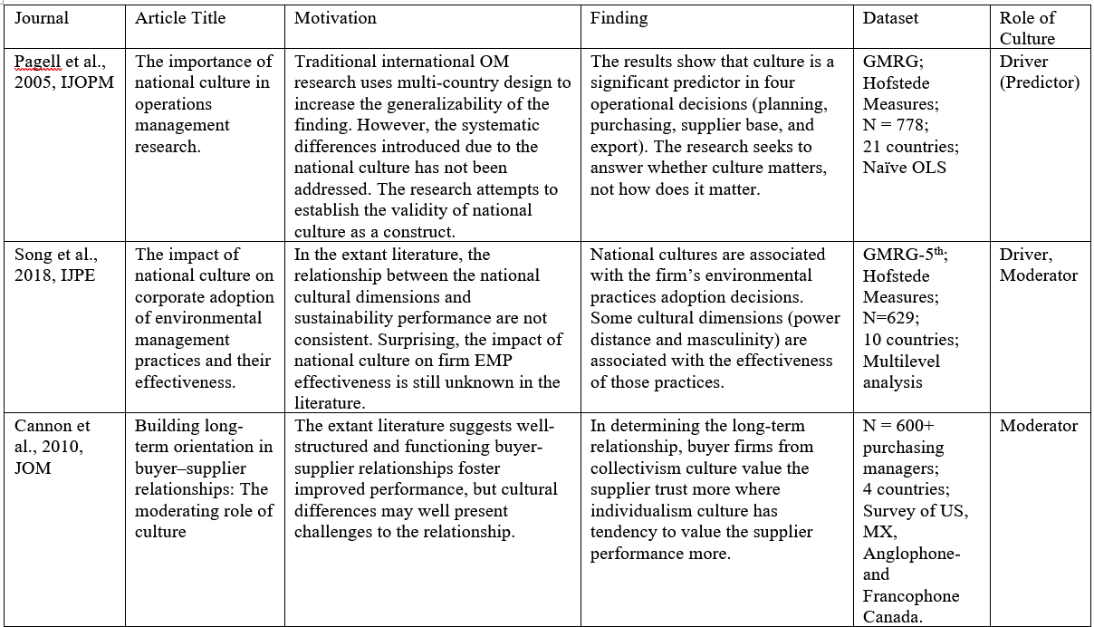
Literature Review (1/3)

Slide 10
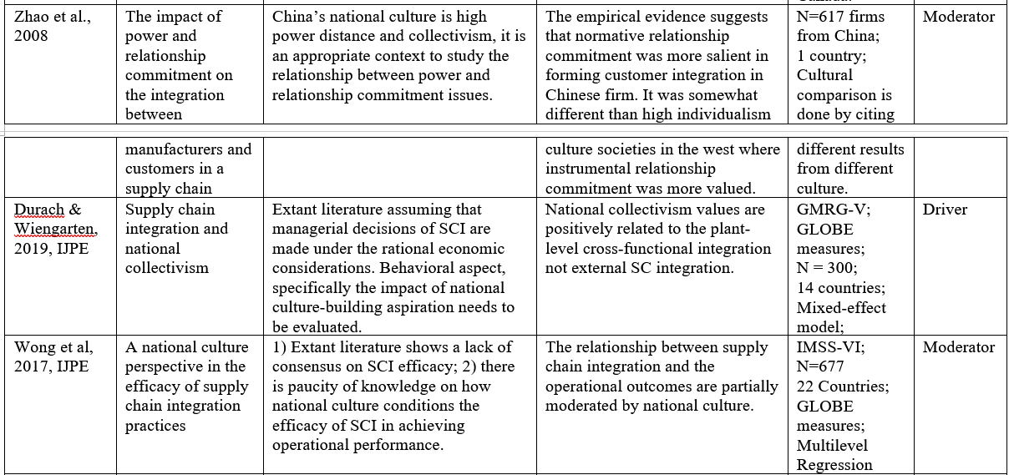
Literature Review (2/3)

Slide 11
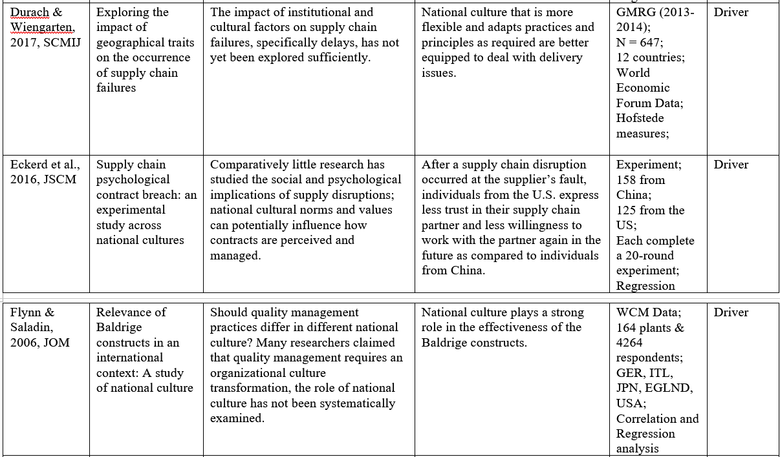
Literature Review (3/3)

Slide 12
Research Opportunities
Extant OSCM research studied the impact of the national culture using a small-scale empirical evidences.
Only studied with a limited number of countries or very small sample sizes for each country.
A more systematic investigation based on a large-scale empirical evidence is needed.

Slide 13
Theoretical Development: Theory base
Behavioral operations management
  Neo-classical economic theories suggest that managers make rational decisions that maximize the utility and the profits (Becker, 1976).
  However, recent discoveries in the behavioral operations management literature suggest that people often make decisions that are not rational and thus achieve profits far less than the theoretical predictions (Schweitzer & Cachon, 2000; Croson & Donohue, 2006; Chen & Zhao, 2015).
  Increasingly, scholars identify the linkages between the behavioral causes to the national culture (Eckerd et al., 2016; Durach & Wiengarten, 2019; Li et al., 2019).
Hofstede Cultural Theory
  The collective programming of the mind that distinguishes the members of one group or category of people from others (Hofstede, 1980)
  The national culture is known to related to the various level of risk perception (cognitive dimension) and behavioral motives (behavioral dimension);

Slide 14
Theoretical Development: Conceptual Model
National Culture Traits
Countries in different national culture will have different level of agility practices.
Regression language: Intercept
OSCM Agility Practices
Agility Outcome
Agility practices will be more effective in countries with certain cultural traits.
Regression language: Slope
Notes:
The national culture exogenously determines the level of intercept and the slope between agility practices and agility outcome.

Slide 15
Agility Practices: A Second-order Construct
The extent to which production activities are constantly forecasted and monitored through prudent planning and use of technology.
Sensing capability in production
Sensing capability in supply chain
The extent to which supply chain activities are carefully planned, information are actively shared, and changes are constantly monitored.
OSCM Agility Practices
Proactive risk management
The extent to which swift reactions are enabled and encouraged through implementation of emergency planning and slack resources.
Proactive workforce development
The extent to which workforces are equipped and empowered to freely and effectively respond in times of sudden changes.

Slide 16
Agility Outcome: A Second-order Construct
The level of flexibility in terms of volume, product mix, ability to customize, and launching new products.
Flexibility Outcome
Agility Outcome
Speed Outcome
The timing and the reliability of the delivery. Also include manufacturing and procurement lead time.

Slide 17
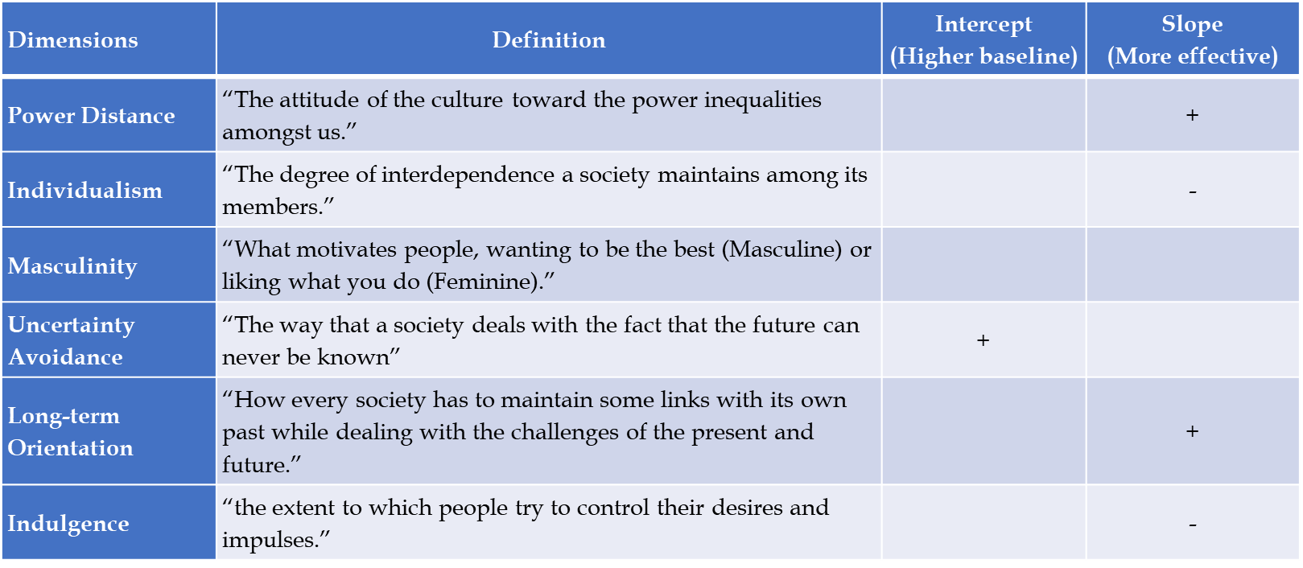
Hypotheses (1/2) – Work-in-Progress
Cultural dimensions and agility practices (H{1-6}a & H{1-6}b)
H7. The dynamics between the agility practices and the agility outcome will work differently in firms with a greater level of international operations.
Still a work-in-progress…
Dimensions | Definition | Intercept (Higher baseline) | Slope (More effective)
Power Distance | “The attitude of the culture toward the power inequalities amongst us.” |  | +
Individualism | “The degree of interdependence a society maintains among its members.” |  | -
Masculinity | “What motivates people, wanting to be the best (Masculine) or liking what you do (Feminine).”
Uncertainty Avoidance | “The way that a society deals with the fact that the future can never be known” | +
Long-term Orientation | “How every society has to maintain some links with its own past while dealing with the challenges of the present and future.” |  | +
Indulgence | “the extent to which people try to control their desires and impulses.” |  | -

Slide 18
Data – International Manufacturing Strategy Survey VI
Survey | Year | ISIC | N | # Countries
IMSS I | 1992 | 381-385 | 600 | 20
IMSS II | 1996 | 381-385 | 703 | 26
IMSS III | 2000 | 381-385 | 558 | 23
IMSS IV | 2005 | 28-35 (Rev 3.1) | 709 | 23
IMSS V | 2009 | 28-35 (Rev 3.1) | 750 | 21
IMSS VI | 2013 | 25-30 (Rev 4.0) | 931 | 22
The International Manufacturing Strategy Survey (IMSS) is a research project carried out in 1992, 1996, 2001, 2005, 2009 and 2013-2014 by a global network of scholars.
This project originally launched by the London Business School and Chalmers University of Technology, studies manufacturing and supply chain strategies within the assembly industry through a detailed questionnaire administered simultaneously in many countries by local research groups.
The number of countries it has studied makes the dataset a very meaningful empirical evidence for this study.
Website: http://www.manufacturingstrategy.net/

Slide 19
Data - Cultural Dimensions – An Illustration of Hofstede Framework
The dimensions of the national culture and the data for each countries are available through
  Hofstede Cultural Dimension Data
  Measured as index (min = 0, max = 100)

Slide 20
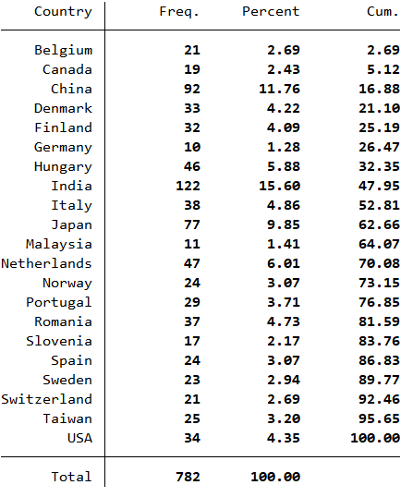
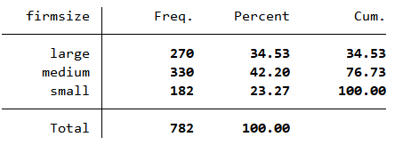
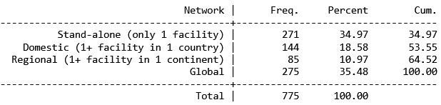
IMSS Respondents’ Profile

Slide 21
Analytical Framework – Multilevel Mixed-Effect Model (1/2)
Measured in Country Level
Measured in Firm Level
Firm ID | Country | Ctry-idv | Ctry-uai | OSCM practice | OSCM performance
001 | USA | 91 | 46 | 4 | 5
002 | USA | 91 | 46 | 3 | 4
003 | USA | 91 | 46 | 3 | 5
… | … | … | … | … | …
045 | Turkey | 37 | 85 | 4 | 4
046 | Turkey | 37 | 85 | 3 | 3
The independence assumption is violated. The residuals from the same country or same cluster may be correlated.
Ecological fallacy (blindly stretching group traits to individual firms.) (Ketokivi, 2019)
Ketokivi, M. (2019). Avoiding bias and fallacy in survey research: A behavioral multilevel approach. Journal of Operations Management, 65(4), 380-402.

Slide 22
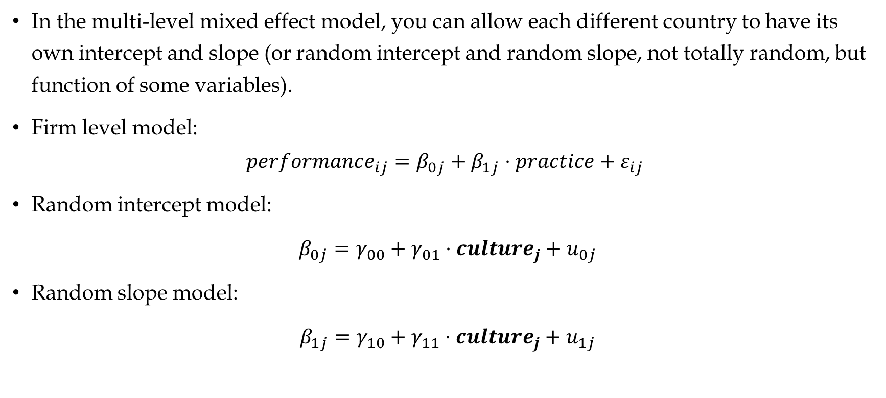
Analytical Framework – Multilevel Mixed-Effect Model (2/2)
In the multi-level mixed effect model, you can allow each different country to have its own intercept and slope (or random intercept and random slope, not totally random, but function of some variables).
Firm level model:
$$performance_{ij}=β_{0j}+β_{1j}⋅practice+ε_{ij}$$
Random intercept model:
$β_{0j}=γ_{00}+γ_{01}⋅culture_{j}+u_{0j}$
Random slope model:
$β_{1j}=γ_{10}+γ_{11}⋅culture_{j}+u_{1j}$

Slide 23
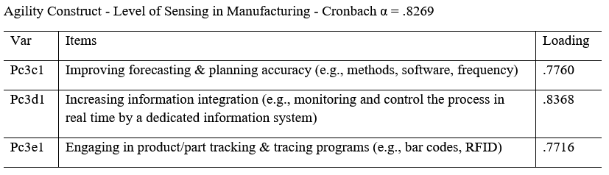
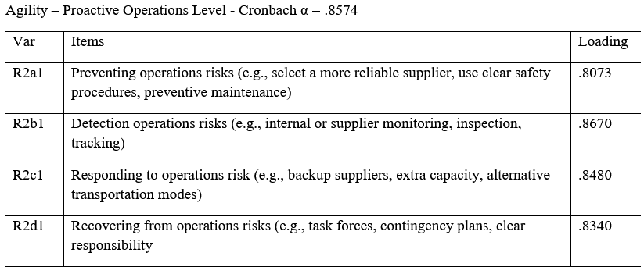
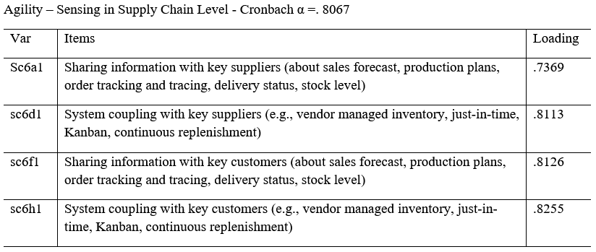
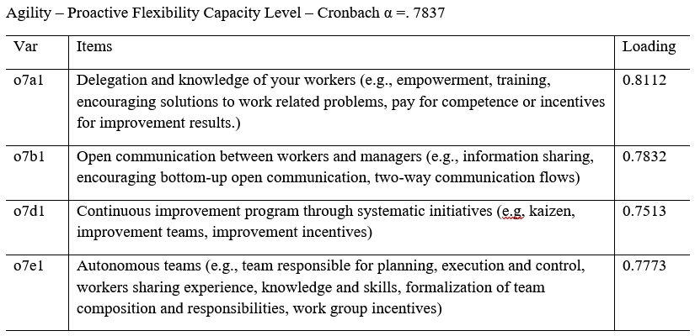
Measurement Items for Agility Practices

Slide 24
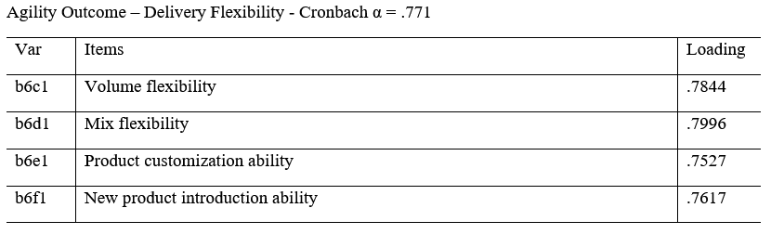
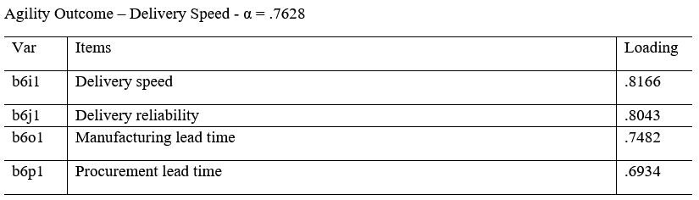
Measurement Items for Agility Outcome

Slide 25
Preliminary Results (1/5)
Statistical validity of the agility practice construct.
Statistical validity of the agility outcome construct.
Both cases, the second-order construct models are chosen for their theoretical and statistical validity.
Barlett method is used to produce the factor score for each construct.

Slide 26
Preliminary Results (2/5) – Factor Scores for Agility Practices & Outcomes

Slide 27
Preliminary Results (3/5) – Agility Practices

Slide 28
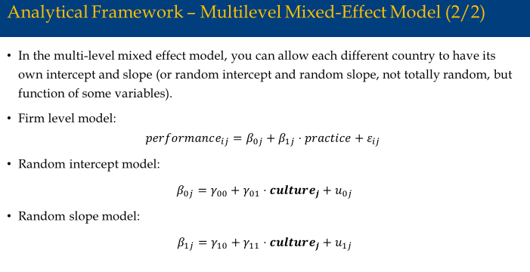
Preliminary Results (4/5) - Effectiveness of Agility Practices
The slope of each country is different.
(The effectiveness of the agility practices vary across countries.)

Slide 29
Preliminary Results (4/5) - Effectiveness of Agility Practices
Within the same country, firms with the greater exposure to multicultural environment show differing level of effectiveness when compared to the regionally operating firms.

Slide 30
Preliminary Results (5/5) –
Multilevel Mixed-Effect Model – Long-term Orientation

Slide 31
Limitations and Challenges
Limitations
  National culture is assumed to be an exogenous factor.
  Used country as the unit of the national culture cluster and within country cultural heterogeneity is not considered.
Challenges
  National culture has six different dimensions. Therefore, it is a bit empirically challenging to include into a statistical model.
    Include all of them in one model – not enough sample size and increased complexity for estimation.
    Include only one in each model – endogeneity concern (omitted variable)

Slide 32
Conclusion
This study contributes to the current literature by providing meaningful insights into the role of national culture in OSCM agility.
The increasing importance of sustainable supply chain management and the unstoppable trend of globalization make it urgent for companies, investors, and policy makers to understand the impact of cultural differences on firm's operations.
As will be revealed by this study, national culture does create a difference in planning and implementing the agility practices.

